Slide 1
Calendar+ Final Report
Authors: Chad Kinnard, Bo Yang Li, Tyler Marrapese, Warren Overstreet

Slide 2
Outline
Project Recap
Technology
Design
Web Page Design
System Architecture
Database & Server
Known Bugs
Future Work

Slide 3
Recap: What is Calendar+?
Calendar+ is a dynamic web application with which the user can create his/her own schedule.
Like any standard calendar web app, the user will be able to create events on any desired valid date.
Calendar+ is a basic CRUD application.

Slide 4
Technology
Languages: HTML/CSS/JavaScript
Backend Runtime: Node.js
External modules used: mysql, web-push
Web Application Framework: Express.js
Middleware: morgan, body-parser, dotenv, nodemon, and express-session
Database: MySQL via XAMPP
Cloud Host: Linode
Editor: Visual Studio Code
Target Platform: Windows 10 > Google Chrome
Version Control System: git
Repository: GitHub

Slide 5
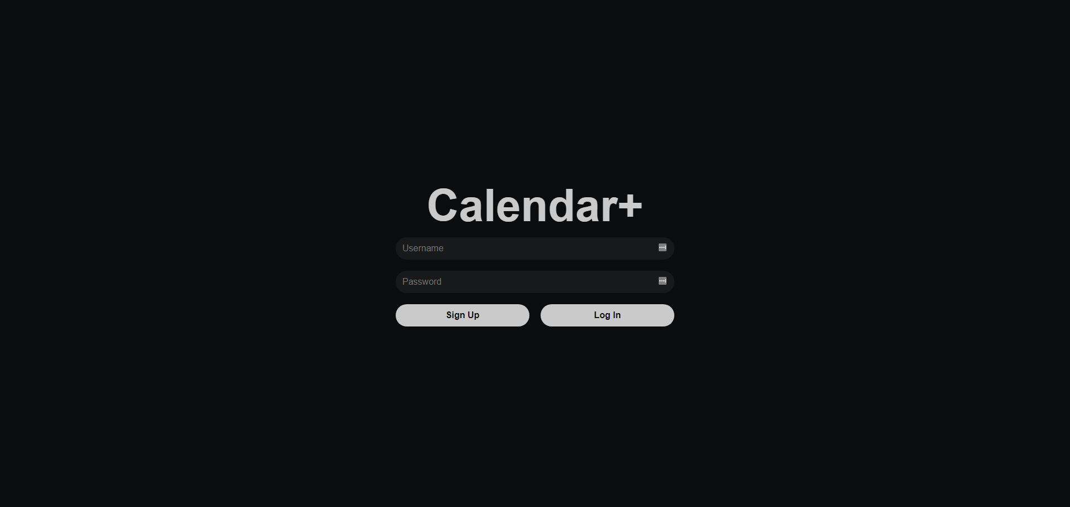
UI Design
Designed with dark mode in mind
Most elements use CSS flex
Uses built in JavaScript Date object for converting and deciding where to display events
Doesn’t use any libraries
All programmed procedurally through JavaScript
Day and Week page had to be displayed using the code from schedule view due to time constraints

Slide 6
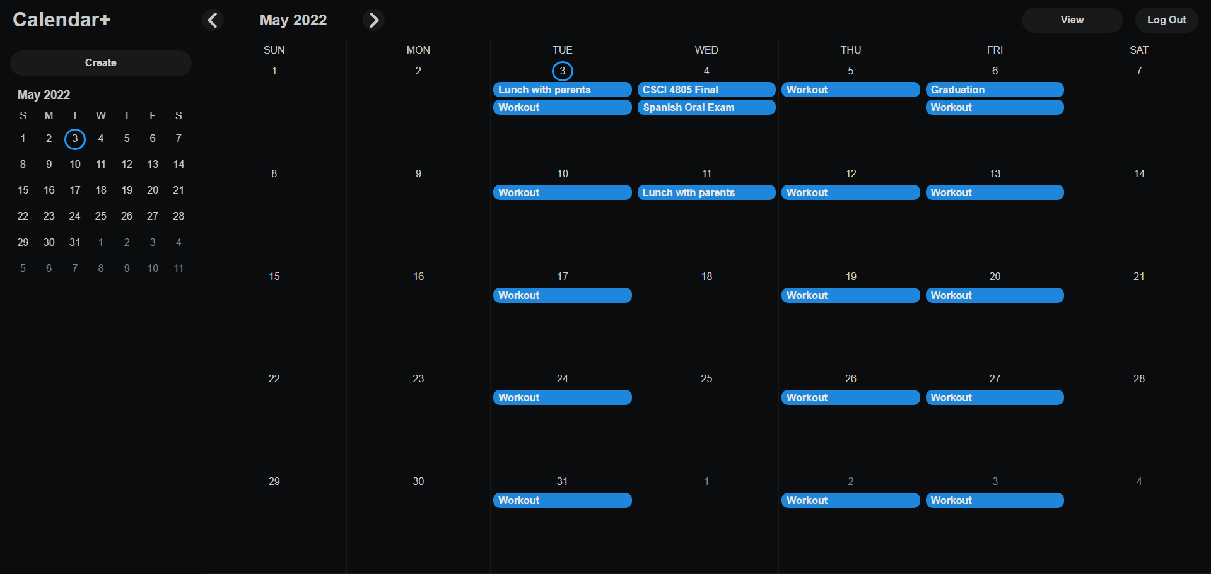
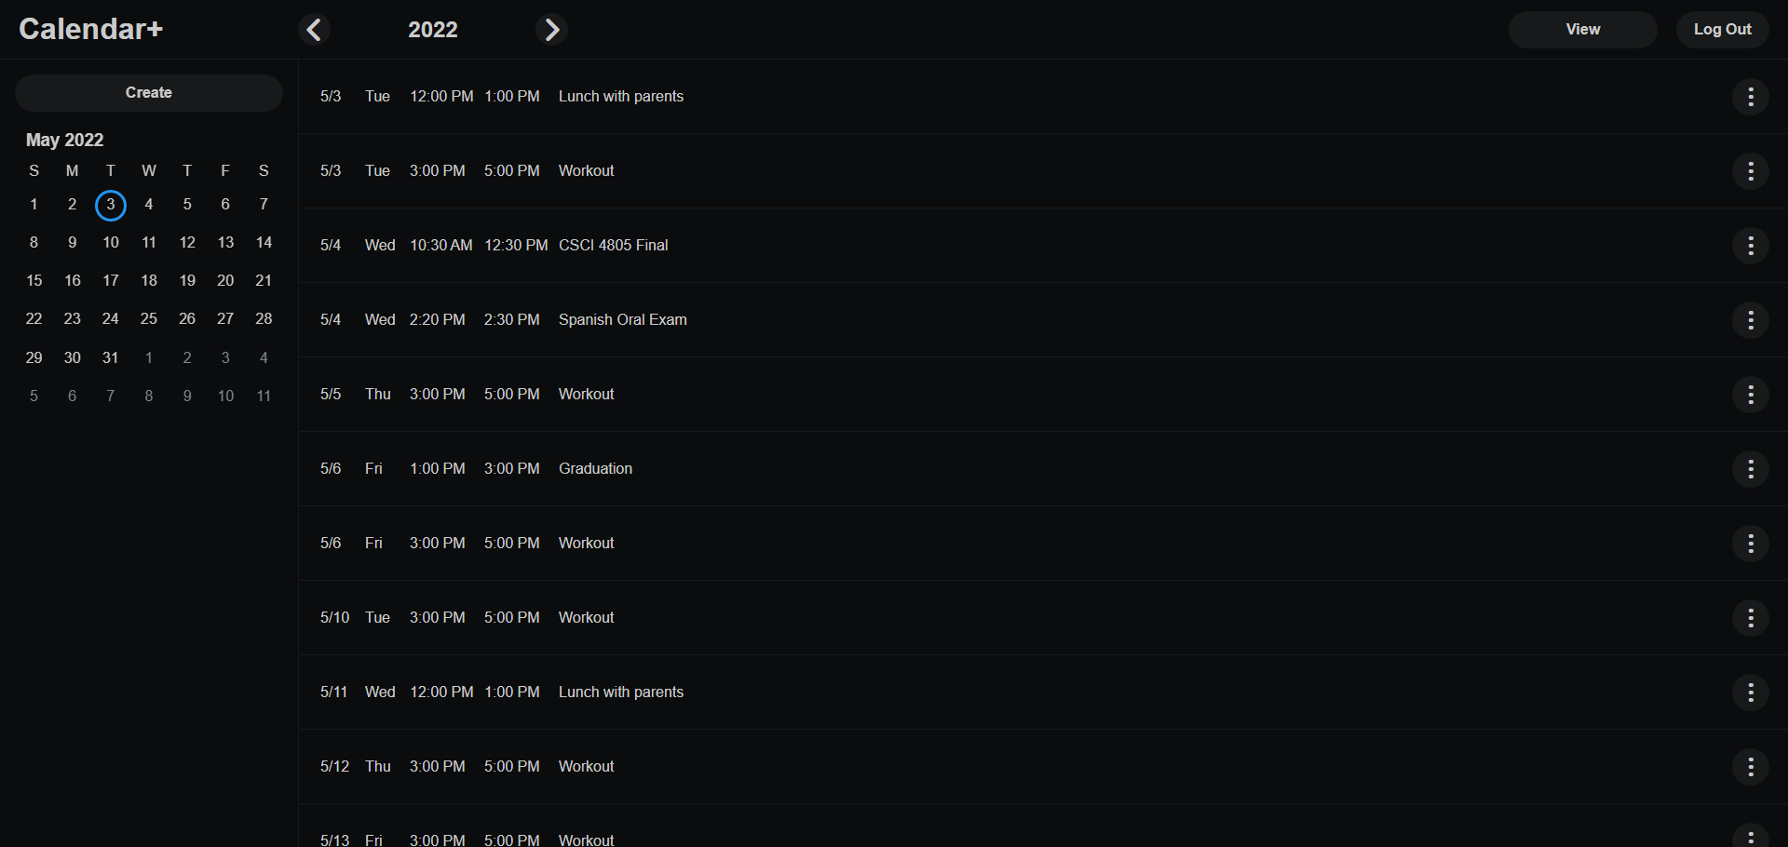
UI Design Cont

Slide 7
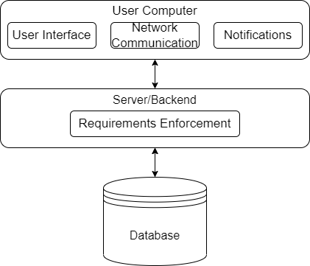
Design - System Architecture
Three Tier Layered Architecture
Presentation: Where the user interacts with the web application
Application: Process information collected in the presentation layer, call CRUD operations in the database, business rules
Database: Where information is stored

Slide 8
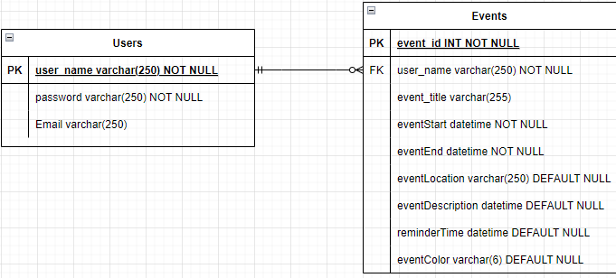
Design - Database & Server
Database has remained almost unchanged
The event_title field was added since the last update.
Some Fields remain unused
Routes have been added to send event data

Slide 9
Known Bugs
Can’t use quotation marks in any fields
February appears with 5 rows instead of 6 some years on year page
Events that span multiple days don’t change date on schedule views
Had to add 5 hours to every event when displaying because of timezone issue with Date object
Dropdown displays behind events on the month page rather than on top.

Slide 10
Future Work
Fully Implement reminders
Allow a color to be added to events
To-do lists
Multiple calendars
Original plan for day and week views
Advanced event search feature
Mobile port
Mobile accounts for 68% of all web usage

Slide 11
Conclusion
We have covered:
Project Recap
Technology
Design
Web Page Design
System Architecture
Database & Server
Known Bugs
Future Work
Thank you for listening.
Any questions?

Slide 12
Linode
http://172.105.159.209:8100

